Slide 1
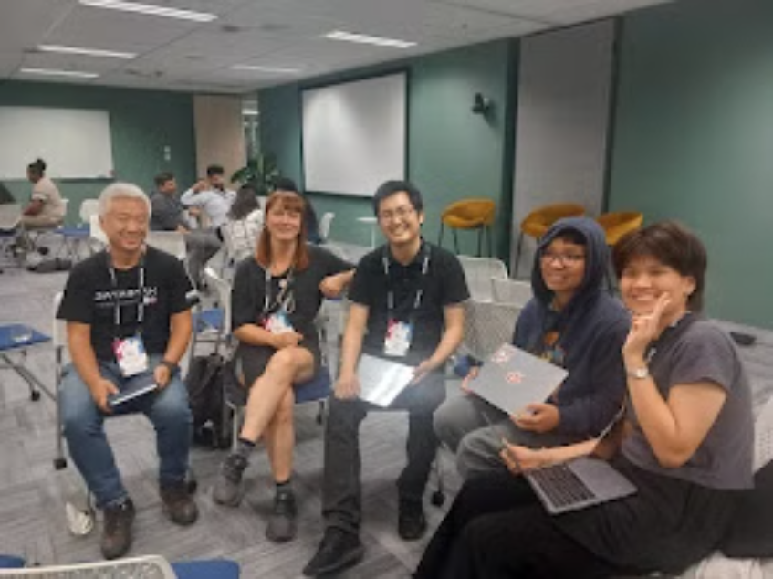

TEAM: GUCK MAL EIN KEKS (Cookiessss)
PROJECT: The Chaos Project

Slide 2
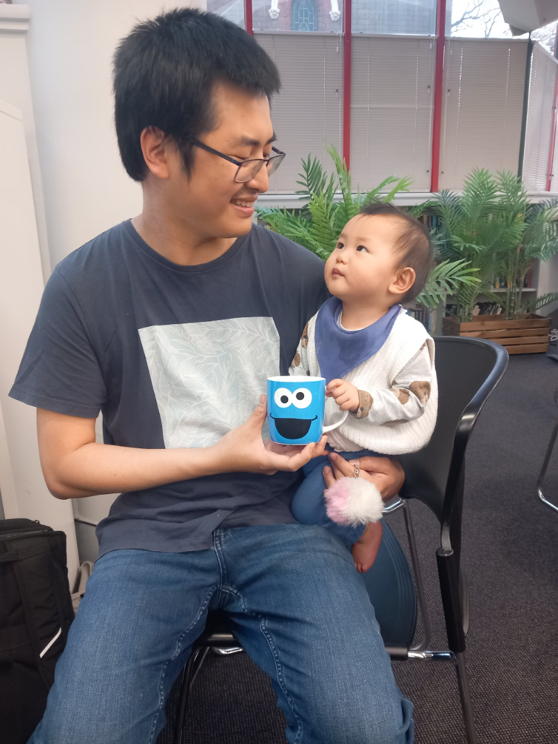
Charley & Lucas
is a loving dad currently enjoying his time during parental leave. Besides that he is a technology consultant. Lucas likes cookies and wants to become a coder

Slide 3
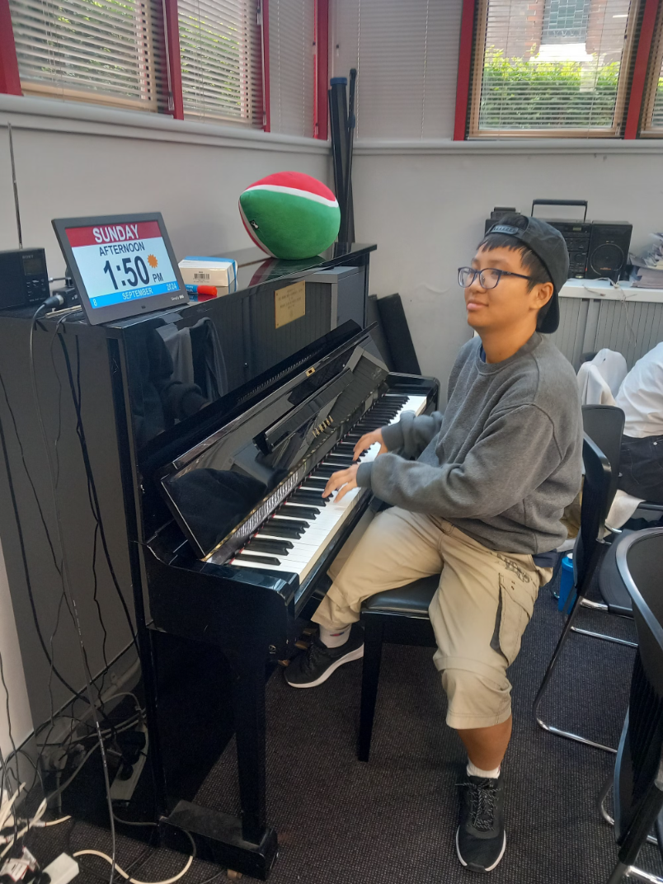
Avery
is a Data Science Student from Sydney and likes to play piano for the mental wellbeing of the group

Slide 4

Jane
is a Data Science Student from Sydney and we are confused in which language we should approach her. Maybe C++ or Python

Slide 5

Kelvin
is a consultant for cyber security based in Sydney. He wants to join a community garden. Hit him up for plant swaps

Slide 6
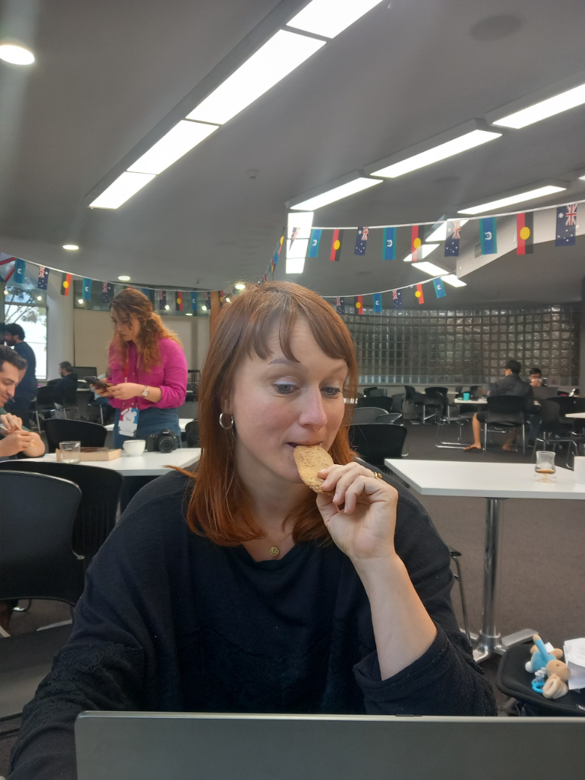
Antje
has a background in Marketing and Urban Developememt. She came all the way from Berlin to join GovHack Sydney. She has no clue about data and would rather go on hiking trips during the hackathon

Slide 7





Enhancing Wellbeing Measurement in ACT
We aim to improve wellbeing measurement in the Australian Capital Territory (ACT). Our goals include exploring external data sources, finding new ways to analyze data, and identifying multi-linked indicators.
5 Contributors
CP

Slide 8
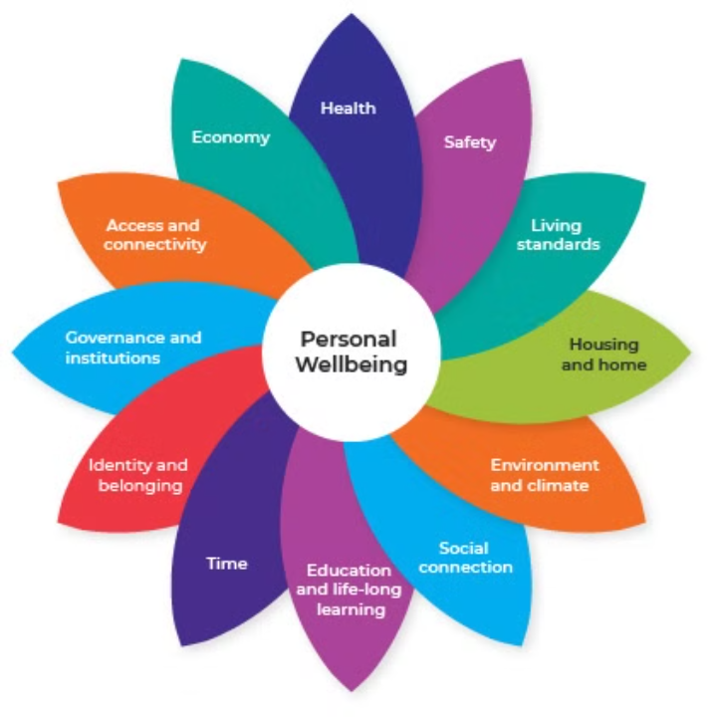
ACT Wellbeing Framework
The ACT Wellbeing Framework looks at 12 aspects of wellbeing – which we call ‘domains’ this is currently measured via 56 indicators. The domains reflect the key factors the community told us impact on the quality of life of Canberrans. The Framework also includes personal wellbeing, which is an overall measure of our life satisfaction. Canberrans generally have higher levels of wellbeing than people living in other parts of Australia – but wellbeing also differs for different people within our community.

Slide 9

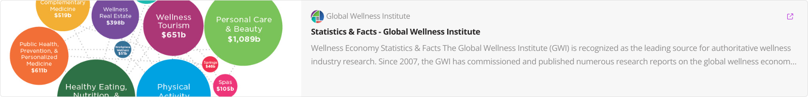


Prior work and Readings

Slide 10
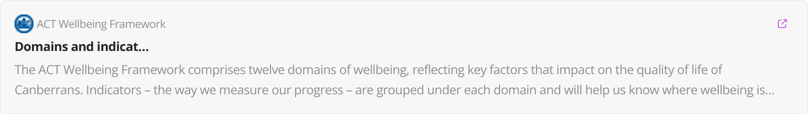
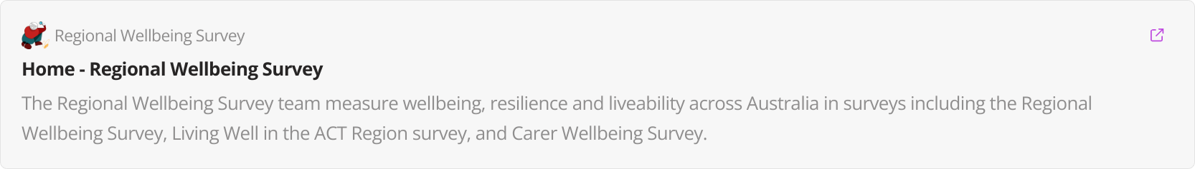

Datasets used

Slide 11
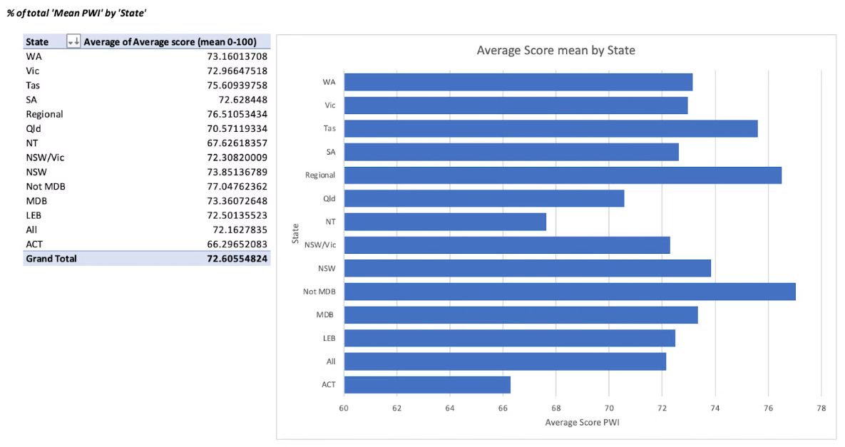
Personal Wellbeing Index Findings (ACT)
1
Average Wellbeing
ACT adults scored 66.29 in 2023, below the national average of 72.16.

Slide 12
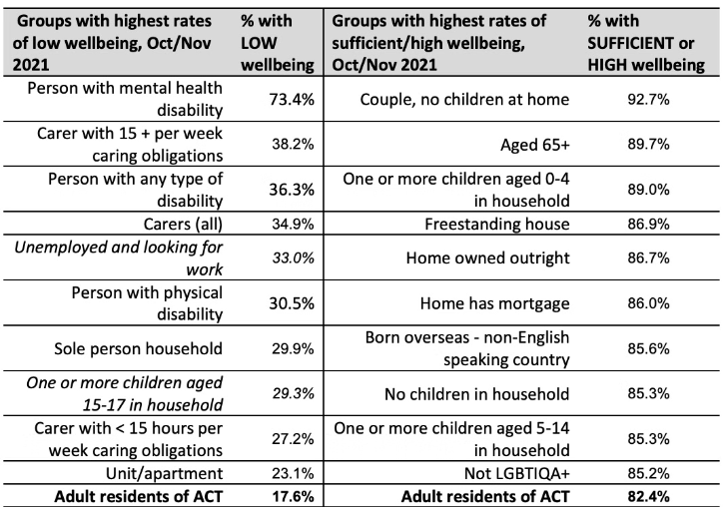
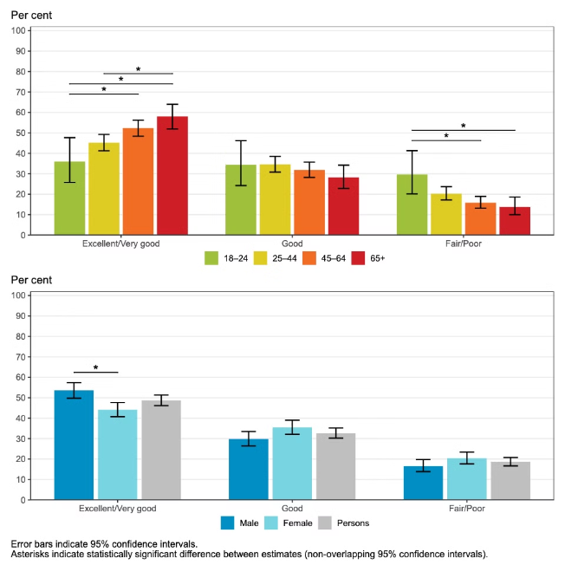

2. Risk groups- People with disabilities, carers, and unemployed individuals had lower wellbeing scores.
3. Higher Wellbeing- Older adults, couples without children, and homeowners reported higher wellbeing.

Slide 13
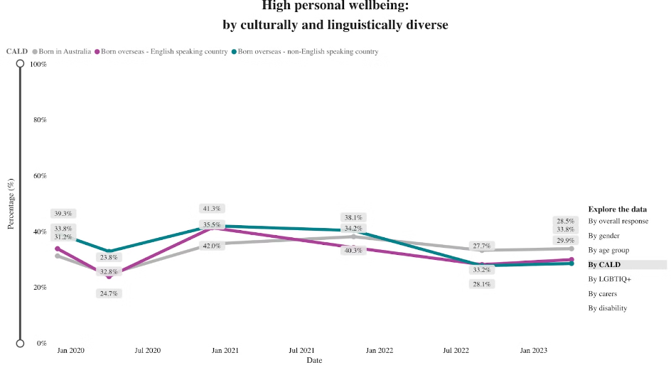
People who are born overseas - non English have better wellbeing index score

Slide 14
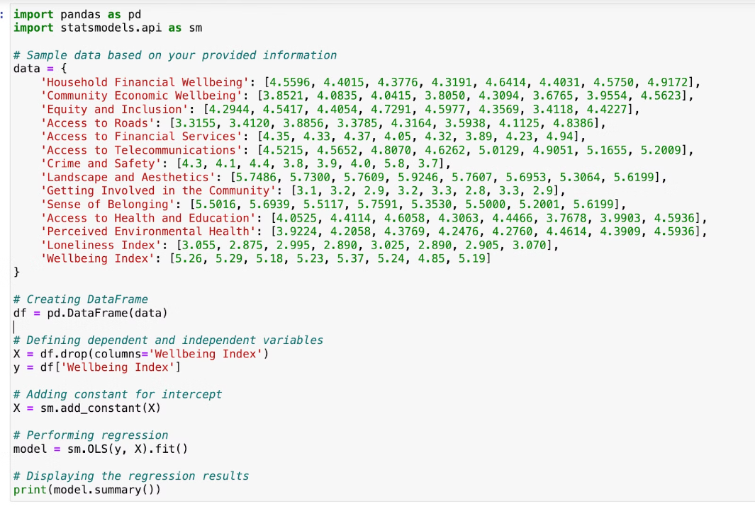
Regression on regional Wellness survey: Quantifying influences by domain

Slide 15
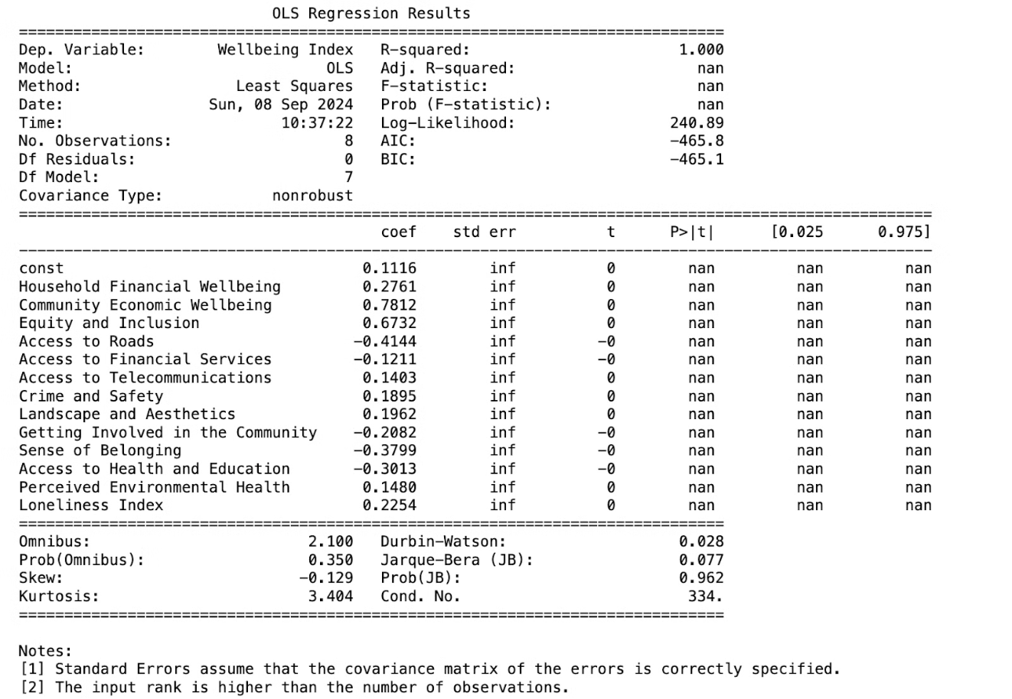

Slide 16
Domain Focus: Community Safety and Domestic Violence
Explore the interaction between safety indicators (e.g., crime data, domestic violence reports) and other wellbeing domains like mental health and housing stability.
Integrate data from domestic violence helplines, police reports, and emergency services to map trends in domestic violence over time. Highlight the role of socioeconomic factors, employment status, and housing situations in predicting vulnerability to domestic violence.
Apply machine learning algorithms to predict high-risk periods or areas for domestic violence, using data from environmental stressors (e.g., economic downturns) and the availability of community support services.

Slide 17
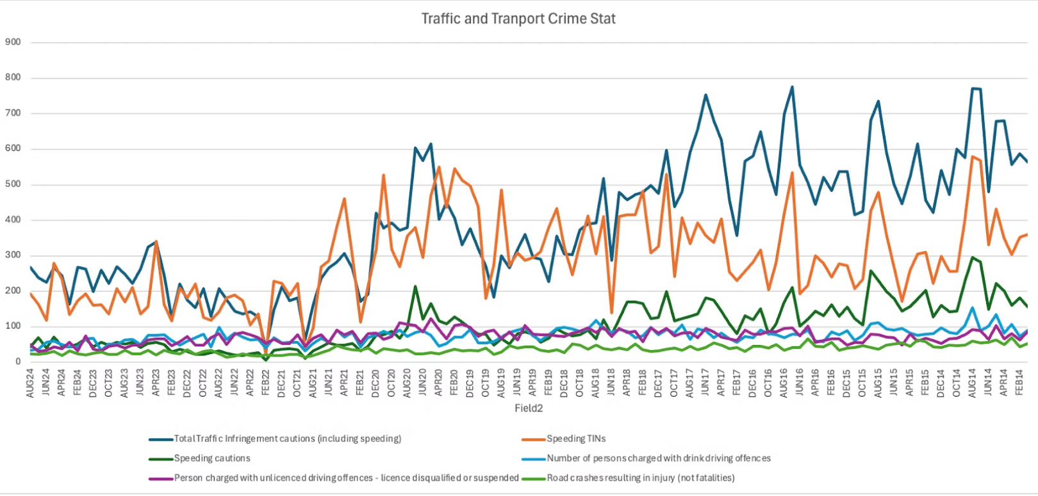
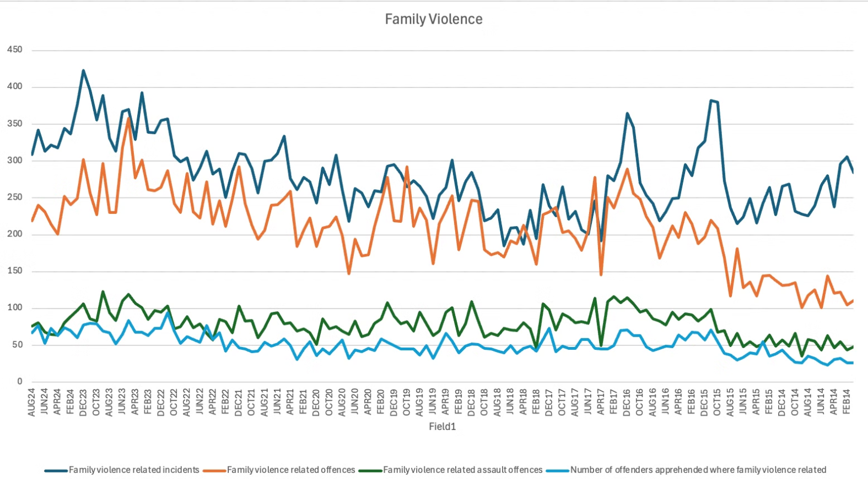
Road safety
Domestic Violence

Slide 18
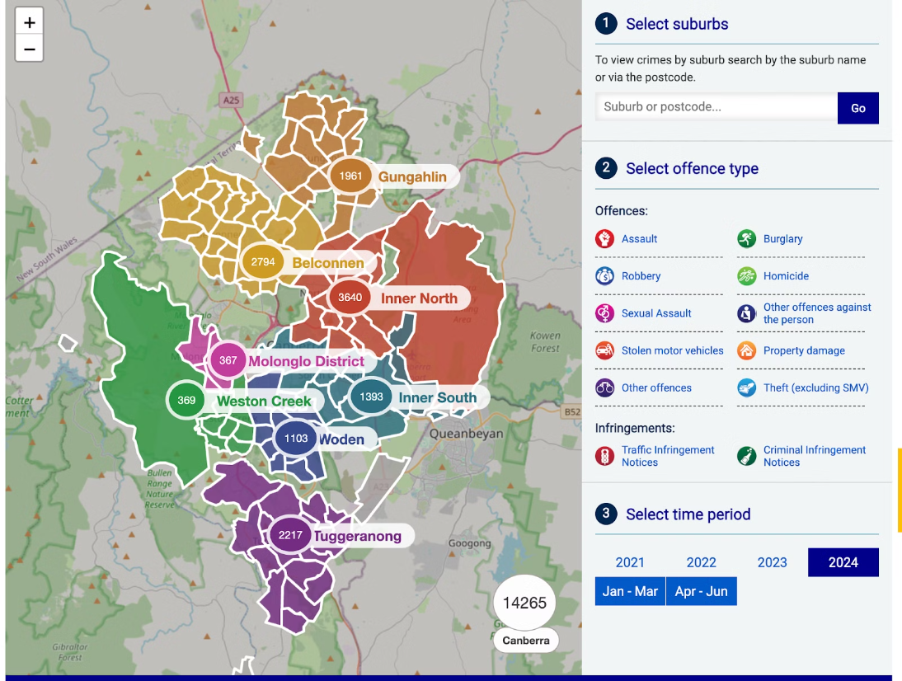

Slide 19
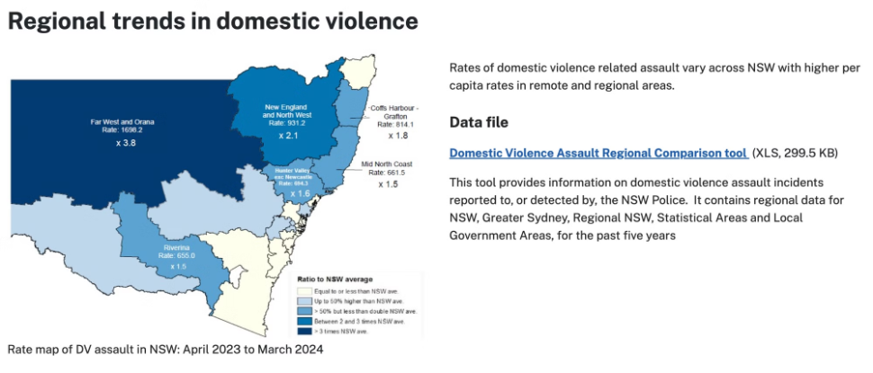
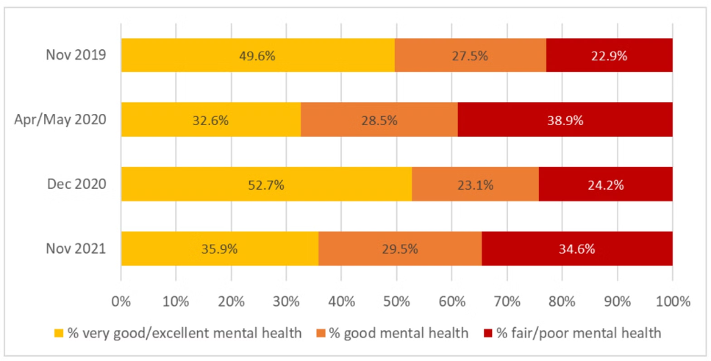

Slide 20
SOCIAL MEDIA IMPACT ON WELL BEING
The research demonstrated real social impact as evidenced by its presence and discussion on social media. —> Use natural language processing (NLP) techniques to analyze social media data and news articles to detect emerging wellbeing trends (such as changes in community sentiment or mental health trends related to specific events, such as economic crises or natural disasters). Link these insights to ACT's Wellbeing Framework domains.

Slide 21
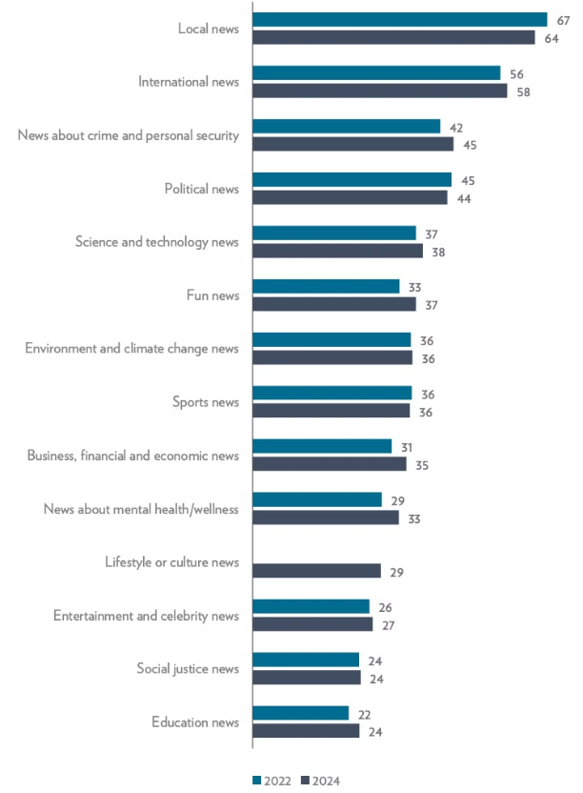
Effect of social media usage
→ There is an increment of people interested in mental health/wellness.

Slide 22
Limitations
The data collection period coincided with societal restrictions due to Covid-19 between 2020 and 2023.
Tried to map regional indexes Access to local government services, Getting involved in the community, Sense of belonging and Access to telecommunications with the ACT wellbeing domain framework Governance and institutions, Social connections, Identify and belonging and Access and connectivity
We also tried to link the ACT with other external wellness surveys, however methodology varies significantly with other data sets. The ACT wellness has far more indicators than other data sources.

Slide 23

Comparisons

Slide 24

Future Directions
Machine Learning
Develop predictive models for high-risk periods of domestic violence.
Data Integration
Combine datasets on civic participation and wellbeing for deeper insights. Ideally this would need to be aligned with other data collection methods (US, OECD, Private Sector) so that information can be compared appropriately
Continuous Improvement
Regularly update measurement methods to capture evolving wellbeing factors.
Additional Data Points
Effect of Social Media usage on wellbeing

